Slide 1



Aetna Supplemental Health Plans
Member
Portal
How to file a claim
©2024 Aetna Inc.
57.25.303.1
Notes:
Welcome and thank you for joining me today. In a moment, you’ll learn just how easy it is to file a supplemental health claim. In most cases, it takes less than two minutes. Ready? Let’s get started…

Slide 2





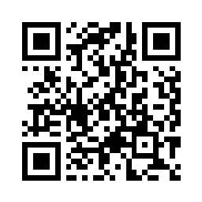

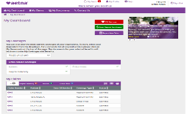
To collect cash benefits, just file a claim
My Aetna Supplemental app or website
Aetna Supplemental Health Plans pay you cash for a covered accident, critical illness or hospital stay. Use the money however you like.
Download the My Aetna Supplemental app or access on the web at MyAetnaSupplemental.com
You can also scan the QR Code
Notes:
To file a claim, download the My Aetna Supplemental app. Or visit MyAetnaSupplemental.com. You can also scan the QR code. If you’re a first-time user, you’ll need to register on our member portal.

Slide 3
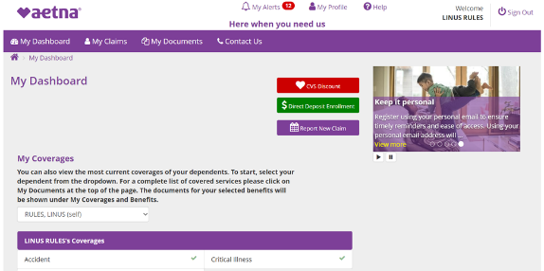

Filing a claim
Click on “Report a New Claim” button and answer the questions to begin filing a claim.
Notes:
Once you sign in, you’ll be on the My Dashboard landing page. To start your claim, simply click on the “Report New Claim” button. You will be guided through the process step-by-step.

Slide 4
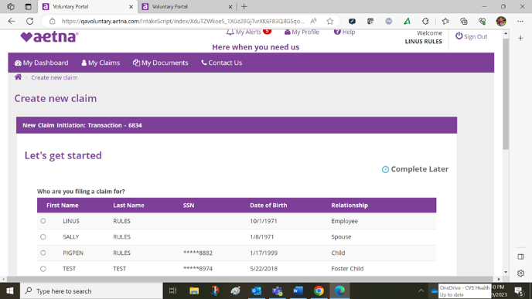
Select the person for whom you are filing a claim
Click the button next to the name of the person for whom you are filing a claim.
Notes:
Next, click the button next to the name of the person for whom you are filing a claim, then click “Save and Continue” at the bottom of the screen.

Slide 5
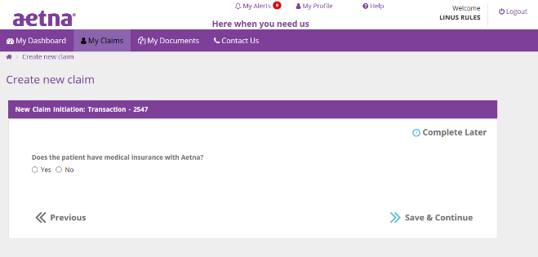
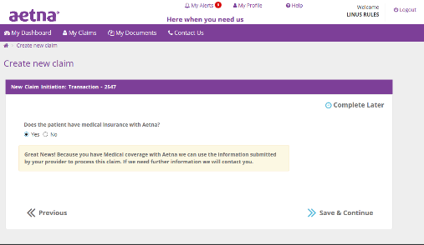
Do you also have medical coverage with Aetna®?
You’re guided through the process step-by-step.
If you have Aetna medical insurance through your employer, no more documentation is usually needed.
Notes:
If you have Aetna medical insurance through your employer, click yes. Typically, no more documentation is needed. We can match your claim right to your medical records. However, if you have non-medical expenses, like lodging and transportation, you’ll be prompted later in the claims experience to upload a picture or PDF of those expenses.

Slide 6
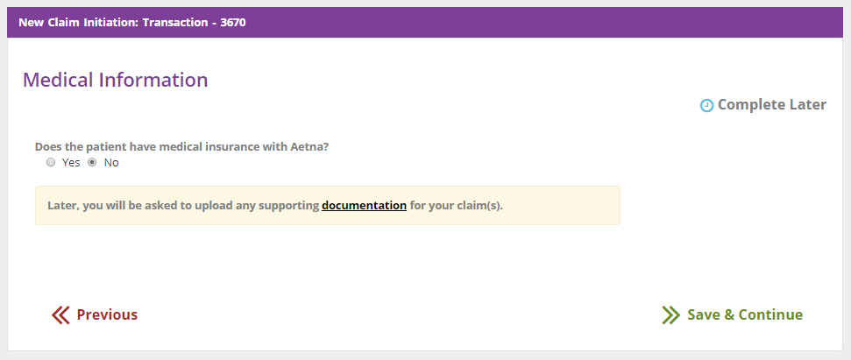

If you don’t have Aetna® medical insurance…
If you answer “no,” you will be prompted to upload medical documentation to complete your claim.
After you’ve started the claim, you can pause the claims process by clicking on the
“Complete Later” button.
Resume filing by going to the “My Alerts” section at the top of the MyAetnaSupplemental.com My Dashboard page.
Notes:
If you don’t have Aetna Medical, click “no.” You’ll be asked to send us an itemized bill or medical reports. Click the word “documentation” to see examples of accepted supporting documents,
If you need a few minutes to gather your paperwork, you can click “complete later.”
When you are ready to resume the process, just click on the “My Alerts” button at the top of the Dashboard page. Then continue right where you left off.

Slide 7
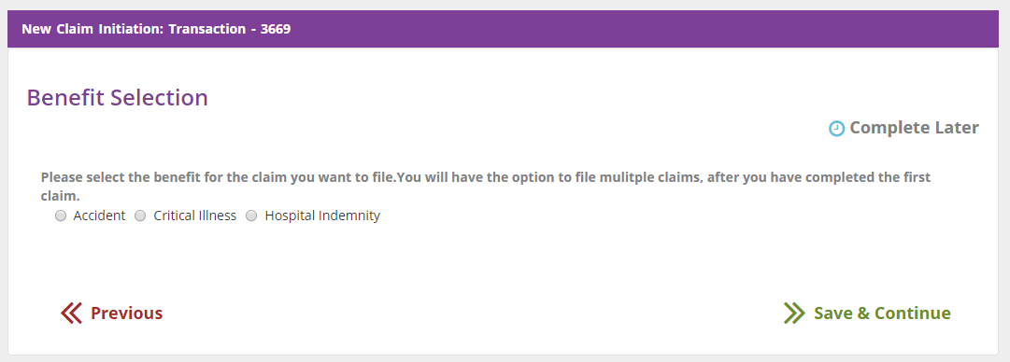
Filing a claim – choose the plan
Select the plan for the claim you want to file.
Notes:
Next you’ll choose the plan for which you are filing the claim. Only the plans you’re enrolled in will appear.

Slide 8
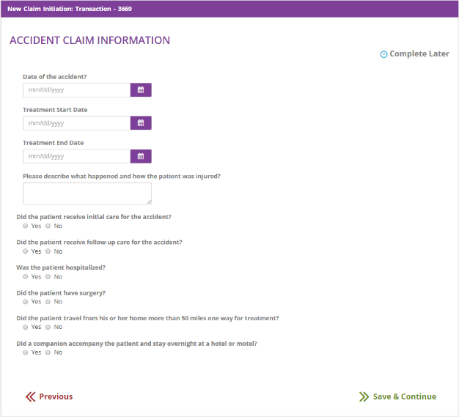
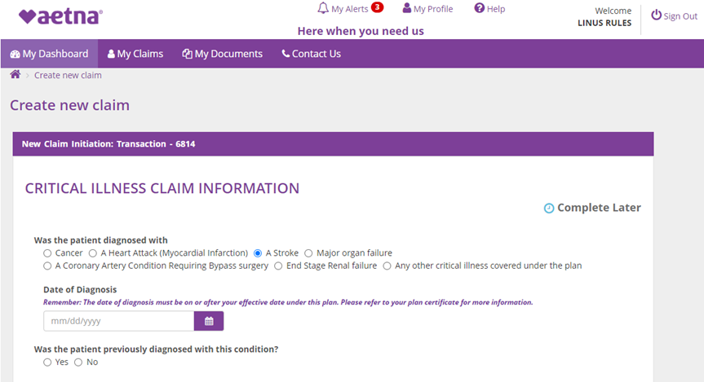
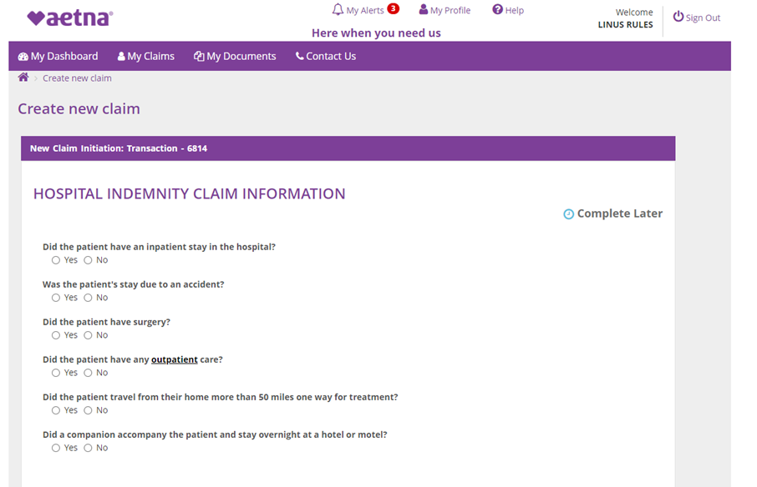
Aetna Simplified Claims Experience™
Fill in the information requested to move on.
Notes:
Now you’ll be asked to complete a few questions about your medical event. Each plan-type will require specific information.

Slide 9
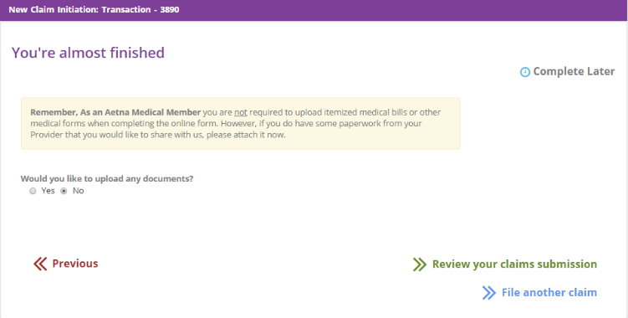
Filing a claim – if medical documents needed
If you are an Aetna Medical member, you’re not required to upload medical documents supporting the claim.
You have an option to start another claim before submitting your current claim.
Notes:
You’re almost finished! If you are an Aetna Medical member and incurred non-medical expenses for transportation and lodging, or if supporting medical reports would be helpful, you can upload that information now.
And if you wish to start another claim before completing your current claim, you can do so from here.

Slide 10
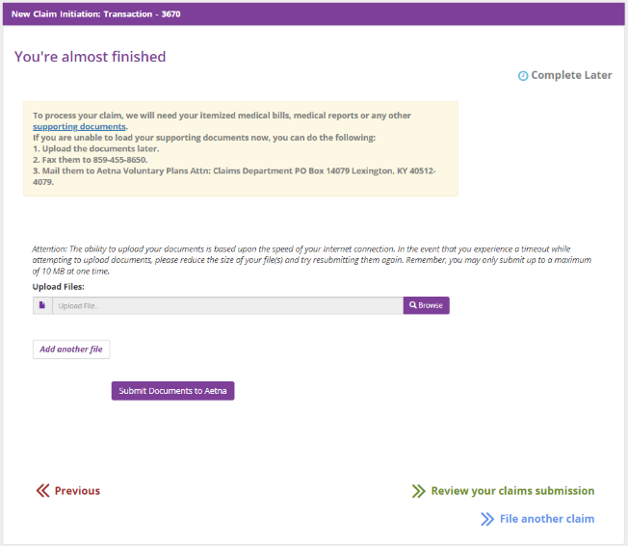
Filing a claim – when medical documents are needed
If you’re not an Aetna Medical member, you’ll be prompted to upload medical documents supporting the claim.
Uniform Medical Billing form 2004 (UBO4) is also acceptable documentation. Please note: an Explanation of Benefits (EOB) is not accepted documentation.
Notes:
If you’re not an Aetna Medical member, you’ll be prompted to upload medical documents supporting the claim.
Accepted documents include an itemized bill, medical reports, or Uniform Medical Billing form 2004 (UBO4).
Please note, an EOB does not have medical codes, so does not provide enough information for us to complete your claim.

Slide 11
Filing a claim – fax number and mailing address
Supporting documentation can be faxed to: 1-859-455-8650
Or you can mail them to:
Aetna Voluntary Plans
Attn: Claims Department
PO Box 14079
Lexington, KY 40512
If you’re unable to upload your documents online, you can fax or mail them.
Notes:
If, for some reason, you cannot upload your supporting documents due to file size or poor internet connectivity — send them to us. Here’s our address and fax number. Simply pause the video to take a picture or screen shot for easy reference.

Slide 12
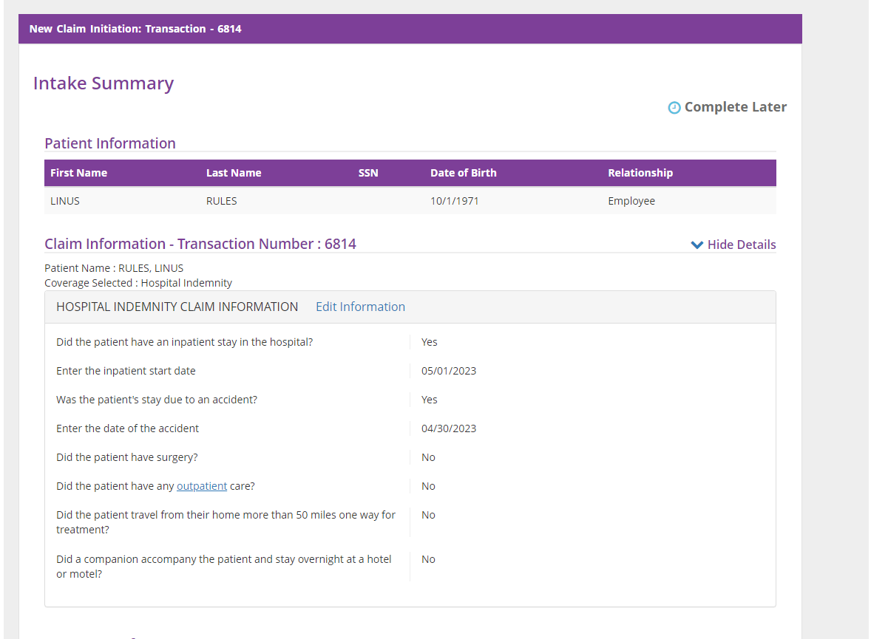

Review your claim before submitting
After finalizing your claim, you can review before submission and edit if needed.
Notes:
Next, review and edit your claim to make sure all your information is correct.

Slide 13
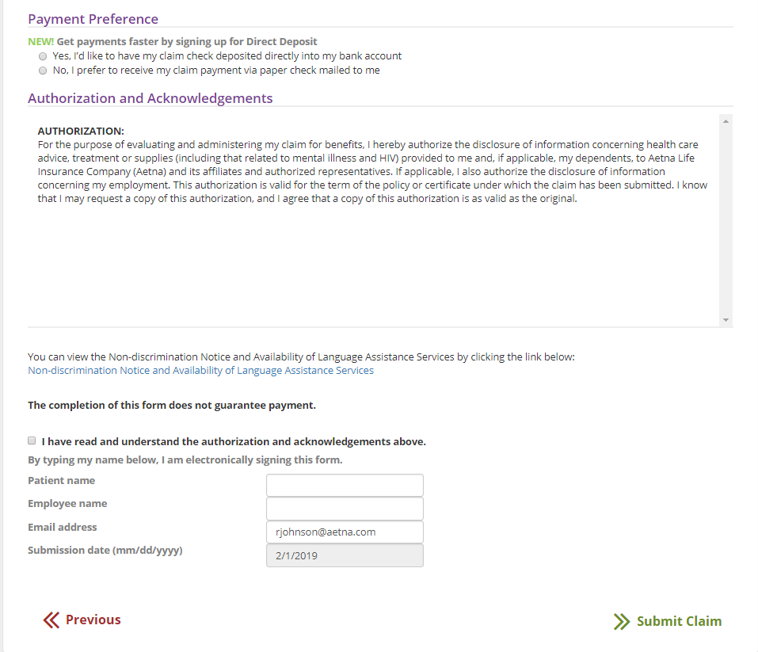
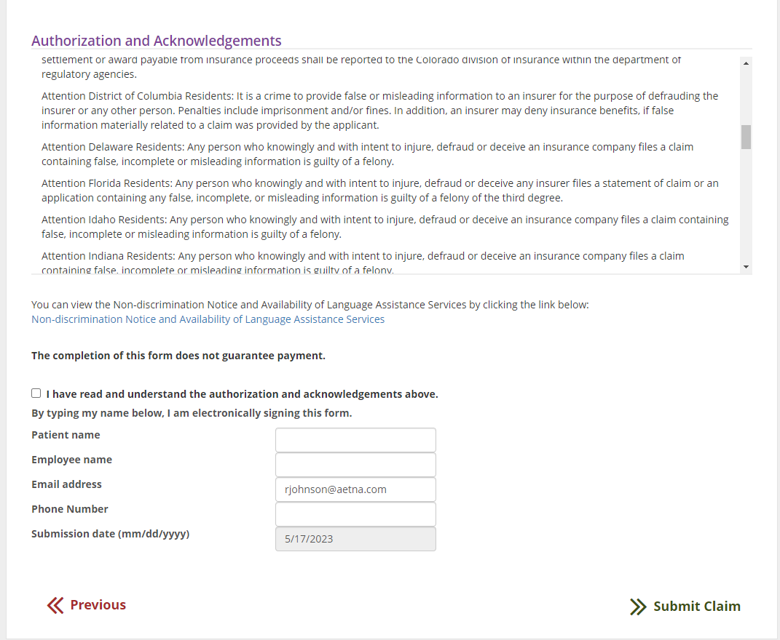
Sign and submit
You also have an opportunity to sign up for direct deposit.
This is the last step for electronic signature and to submit the claim.
Notes:
Finally, you can sign up for direct deposit, or we’ll mail you a check once your claim is approved. When you’re ready, click submit.
It’s that fast and easy. If we have questions or need additional information, we’ll contact you.

Slide 14

We’re here to help
If you have questions about the plans, call member services:
Toll free number:
1-800-607-3366 (TTY: 711)
Knowledgeable customer
service representatives
Convenient hours of operation, Monday – Friday, 8AM – 6PM in all time zones
Translation support in Spanish and other languages available
Notes:
You can always call us with your questions or if you need help filing your claim. Our toll-free number is listed here. We’re available Monday through Friday, 8 AM to 6 PM in all time zones.
We’re here to help!

Slide 15
Aetna® is the brand name used for products and services provided by one or more of the Aetna group of companies, including Aetna Life Insurance Company and its affiliates (Aetna).
THIS IS A SUPPLEMENT TO HEALTH INSURANCE AND IS NOT A SUBSTITUTE FOR MAJOR MEDICAL COVERAGE.
THIS PLAN DOES NOT COUNT AS MINIMUM ESSENTIAL COVERAGE UNDER THE AFFORDABLE CARE ACT. LACK OF MAJOR MEDICAL COVERAGE (OR OTHER MINIMUM ESSENTIAL COVERAGE) MAY RESULT IN AN ADDITIONAL PAYMENT WITH YOUR TAXES.
These plans provide limited benefits. They pay fixed dollar benefits for covered services without regard to the health care provider’s actual charges. The benefits payments are not intended to cover the full cost of medical care. You are responsible for making sure the provider’s bills get paid. These benefits are paid in addition to any other health coverage you may have.
Polices are insured by Aetna Life Insurance Company (Aetna). Not all services are covered. Plan features and availability may vary by location and are subject to change.
Refer to Aetna.com for more information about Aetna plans.
Exclusions and limitations: These plans have exclusions and limitations and are subject to United States economic and trade sanctions. See the plan documents for a complete description of benefits, exclusions, limitations and conditions of coverage. The following is a partial list of services and supplies that are generally not covered. However, the plan may contain exceptions to this list based on state mandates or the plan design purchased. Benefits under the policy will not be payable for anything related to:
Accident plan: Certain competitive or recreational activities, including but not limited to: ballooning, bungee jumping, parachuting, skydiving; Any semi-professional or professional competitive athletic contest, including officiating or coaching, for which you receive any payment; Act of war, riot, war; Operating, learning to operate or serving as a pilot or crew member of any aircraft, whether motorized or not; Assault, felony, illegal occupation, or other criminal act; Bacterial infections that are not caused by a cut or wound from an accidental injury; Care provided by immediate family members or any household member; Elective or cosmetic surgery; Nutritional supplements; Suicide or attempt at suicide, intentionally self-inflicted injury, or any attempt at self-inflicted injury, or any form of intentional asphyxiation, except when resulting from a diagnosed disorder; Violating any cellular device use laws of the state in which the accident occurred, while operating a motor vehicle; Accidental injury sustained while intoxicated or under the influence of any drug intoxicant, including those prescribed by a physician that are misused; We will not pay any benefits for a service or supply rendered or received that are not specifically covered or not related to an accidental injury. The stay, visit or service must be on or after the effective date of coverage, while coverage is in force and take place in the United States or its territories.
Critical illness plan: Suicide or attempt at suicide, intentional self-inflicted injury or sickness, any attempt at intentional self-inflicted injury, injury caused by a self-inflicted act or sickness, while sane or insane; except when resulting from a diagnosed disorder in the most current version of the Diagnostic and Statistical Manual (DSM); Being under the influence of a stimulant (such as amphetamines or pitrates), depressant, hallucinogen, narcotic or any other drug intoxicant, including those prescribed by a physician that are misused by the insured person; except when resulting from a diagnosed disorder in the most current version of the DSM; Engaging in an assault, felony, illegal occupation or other criminal act; Any act of war, whether declared or not, or voluntary participation in a riot, rebellion or civil insurrection.

Slide 16
Hospital indemnity plan: Certain competitive or recreational activities, including but not limited to: ballooning, bungee jumping, parachuting, skydiving; Any semi-professional or professional competitive athletic contest, including officiating or coaching, for which you receive any payment; Act of war, riot, war; Operating, learning to operate or serving as a pilot or crew member of any aircraft, whether motorized or not; Assault, felony, illegal occupation, or other criminal act; Care provided by a spouse, parent, child, sibling or any other household member; Cosmetic services and plastic surgery, with certain exceptions; Custodial care; Hospice services, except as specifically provided in the benefits under your plan section of the certificate; Self-harm, suicide, except when resulting from a diagnosed disorder; Violating any cellular device use laws of the state in which the accident occurred, while operating a motor vehicle; Care or services received outside the United States or its territories; Experimental or investigational drugs, devices, treatments, or procedures; Education, training or retraining services or testing; Accidental injury sustained while intoxicated or under the influence of any drug intoxicant; Exams except as specifically provided in the benefits under your plan section of the certificate; Dental and orthodontic care and treatment; family planning services; Any care, prescription drugs, and medicines related to infertility; Nutritional supplements, including but not limited to: food items, infant formulas, vitamins; Outpatient cognitive rehabilitation, physical therapy, occupational therapy, or speech therapy for any reason; Vision-related care.
This material is for information only. Not all health services are covered, and coverage is subject to applicable laws and regulations. These are sample plan designs. State variations may apply. Benefits paid vary by specific services. Plan features, rates, eligibility and availability may vary by location and are subject to change. Providers are independent contractors and are not agents of Aetna®. Aetna does not provide care or guarantee access to health services. Information is believed to be accurate as of the production date; however, it is subject to change. For more information about Aetna plans, refer to Aetna.com.
Policy forms issued in Idaho include GR-96842, AL HPOL-VOL Acc01, GR-96844, GR-96172, and AL VOL HPOL-Hosp 01
Policy forms issued in Missouri & Wyoming include GR-96842 01, AL HPOL-VOL Acc 01, GR-96844 01, AL HCOC-VOL CI 01, AL HPOL-VOL CI 01, and AL VOL HPOL-Hosp 01, GR-96172-01
Policy forms issued in Oklahoma include GR-96841, GR-96843, AL HCOC-VOL CI 01, AL HPOL-VOL CI 01, AL VOL HPOL-Hosp 01, AL VOL HCOC-Hosp 01, AL VOL HCOC-Hosp 01, and GR-96173-HI 01
Policy forms issued in Washington include GR-96842 01, GR-96172 01 and AL VOL HPOL-Hosp 01
©2024 Aetna Inc.
57.25.303.1 (5/23)

